Slide 1



Detachment 842 Career Day
C/Cavazos and C/Campbell
Air Force ROTC Detachment 842
The University of Texas at San Antonio

Slide 2


Overview
Designated Parking
Instructions for Parking
Path To Student Union
Entrance Way
Interior Directions
Contact Info
Air Force ROTC Detachment 842 • We Build Exceptional Officers • The University of Texas at San Antonio

Slide 3

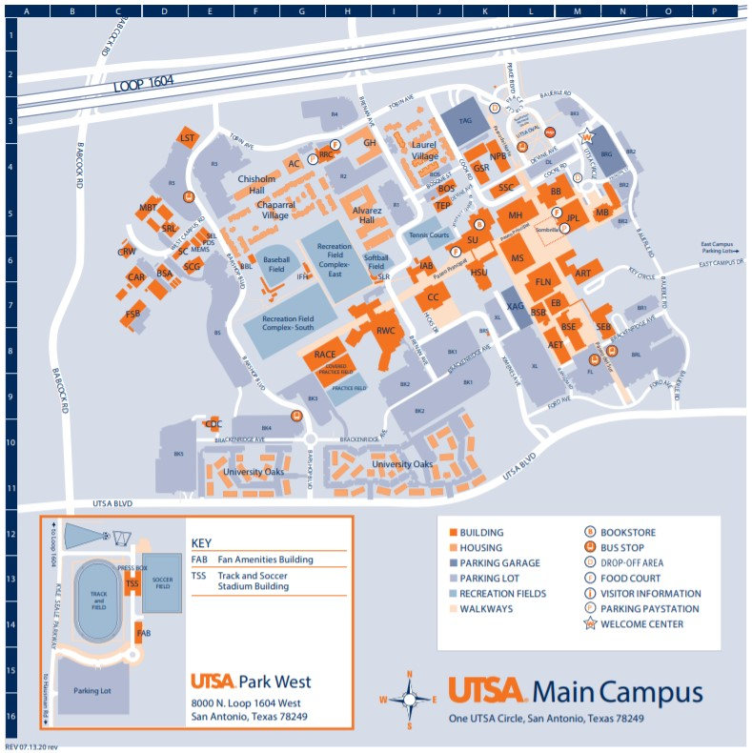
Designated Parking
Address to XAG:
https://maps.app.goo.gl/EbtQ3a53Rku8c25H7
Designated parking for officers at the Ximenes Ave Garage (XAG).
Air Force ROTC Detachment 842 • We Build Exceptional Officers • The University of Texas at San Antonio

Slide 4
Instructions for parking
Enter the Ximenes parking garage and park in an unmarked space.
Once the career day has concluded, parking vouchers will be distributed to everyone that parked a vehicle in the garage, parking will be of no cost to you.
Parking vouchers are for one time use only.
Air Force ROTC Detachment 842 • We Build Exceptional Officers • The University of Texas at San Antonio

Slide 5
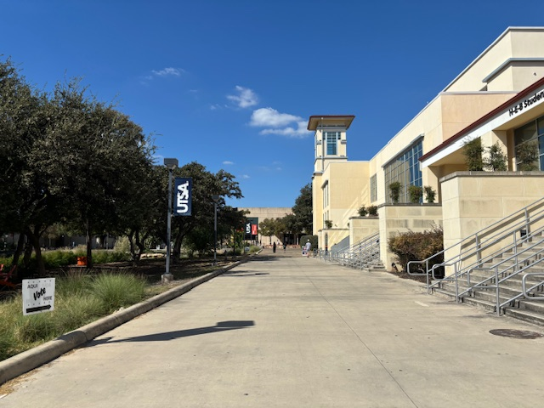
Path to Student Union
Follow path marked by the red arrow. There will also be designated guides to help guide you to the Denman Ballroom.
Address to Student Union: https://maps.app.goo.gl/Ji8g6rRZyRrsLPT2A
Air Force ROTC Detachment 842 • We Build Exceptional Officers • The University of Texas at San Antonio

Slide 6
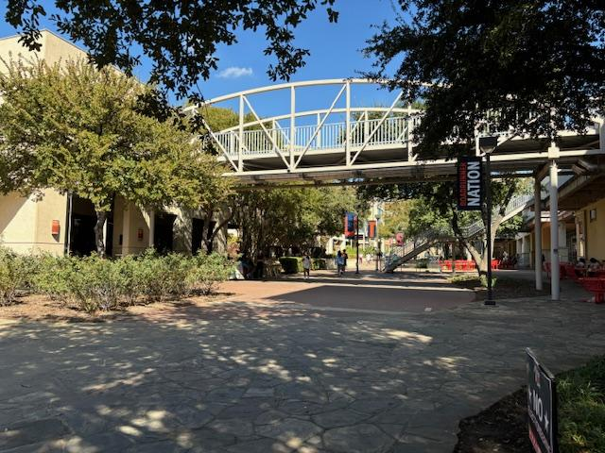
Entrance Way
Enter through the entrance under the breezeway (to the left), it will lead into a building labelled SU (student union).
Air Force ROTC Detachment 842 • We Build Exceptional Officers • The University of Texas at San Antonio

Slide 7
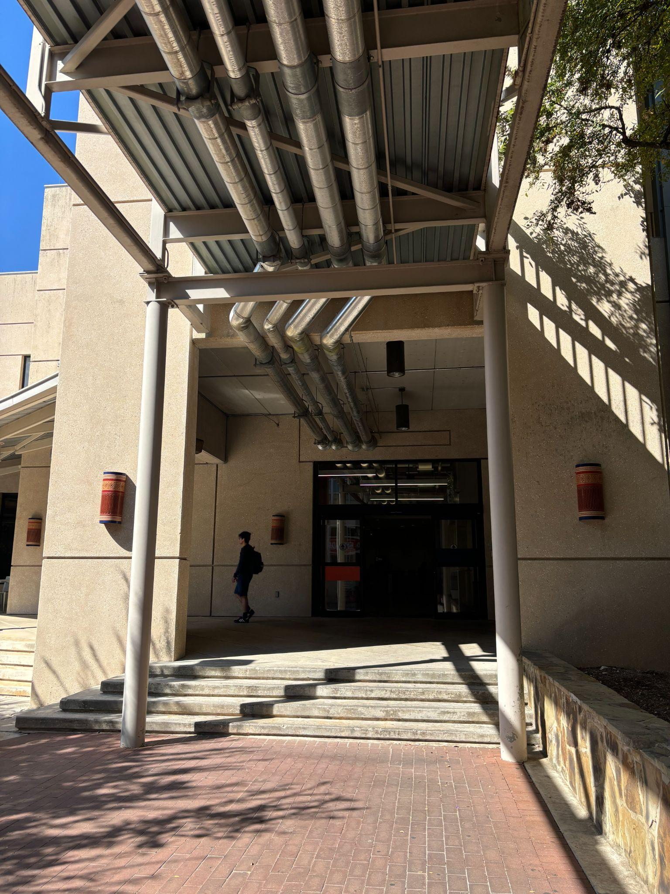
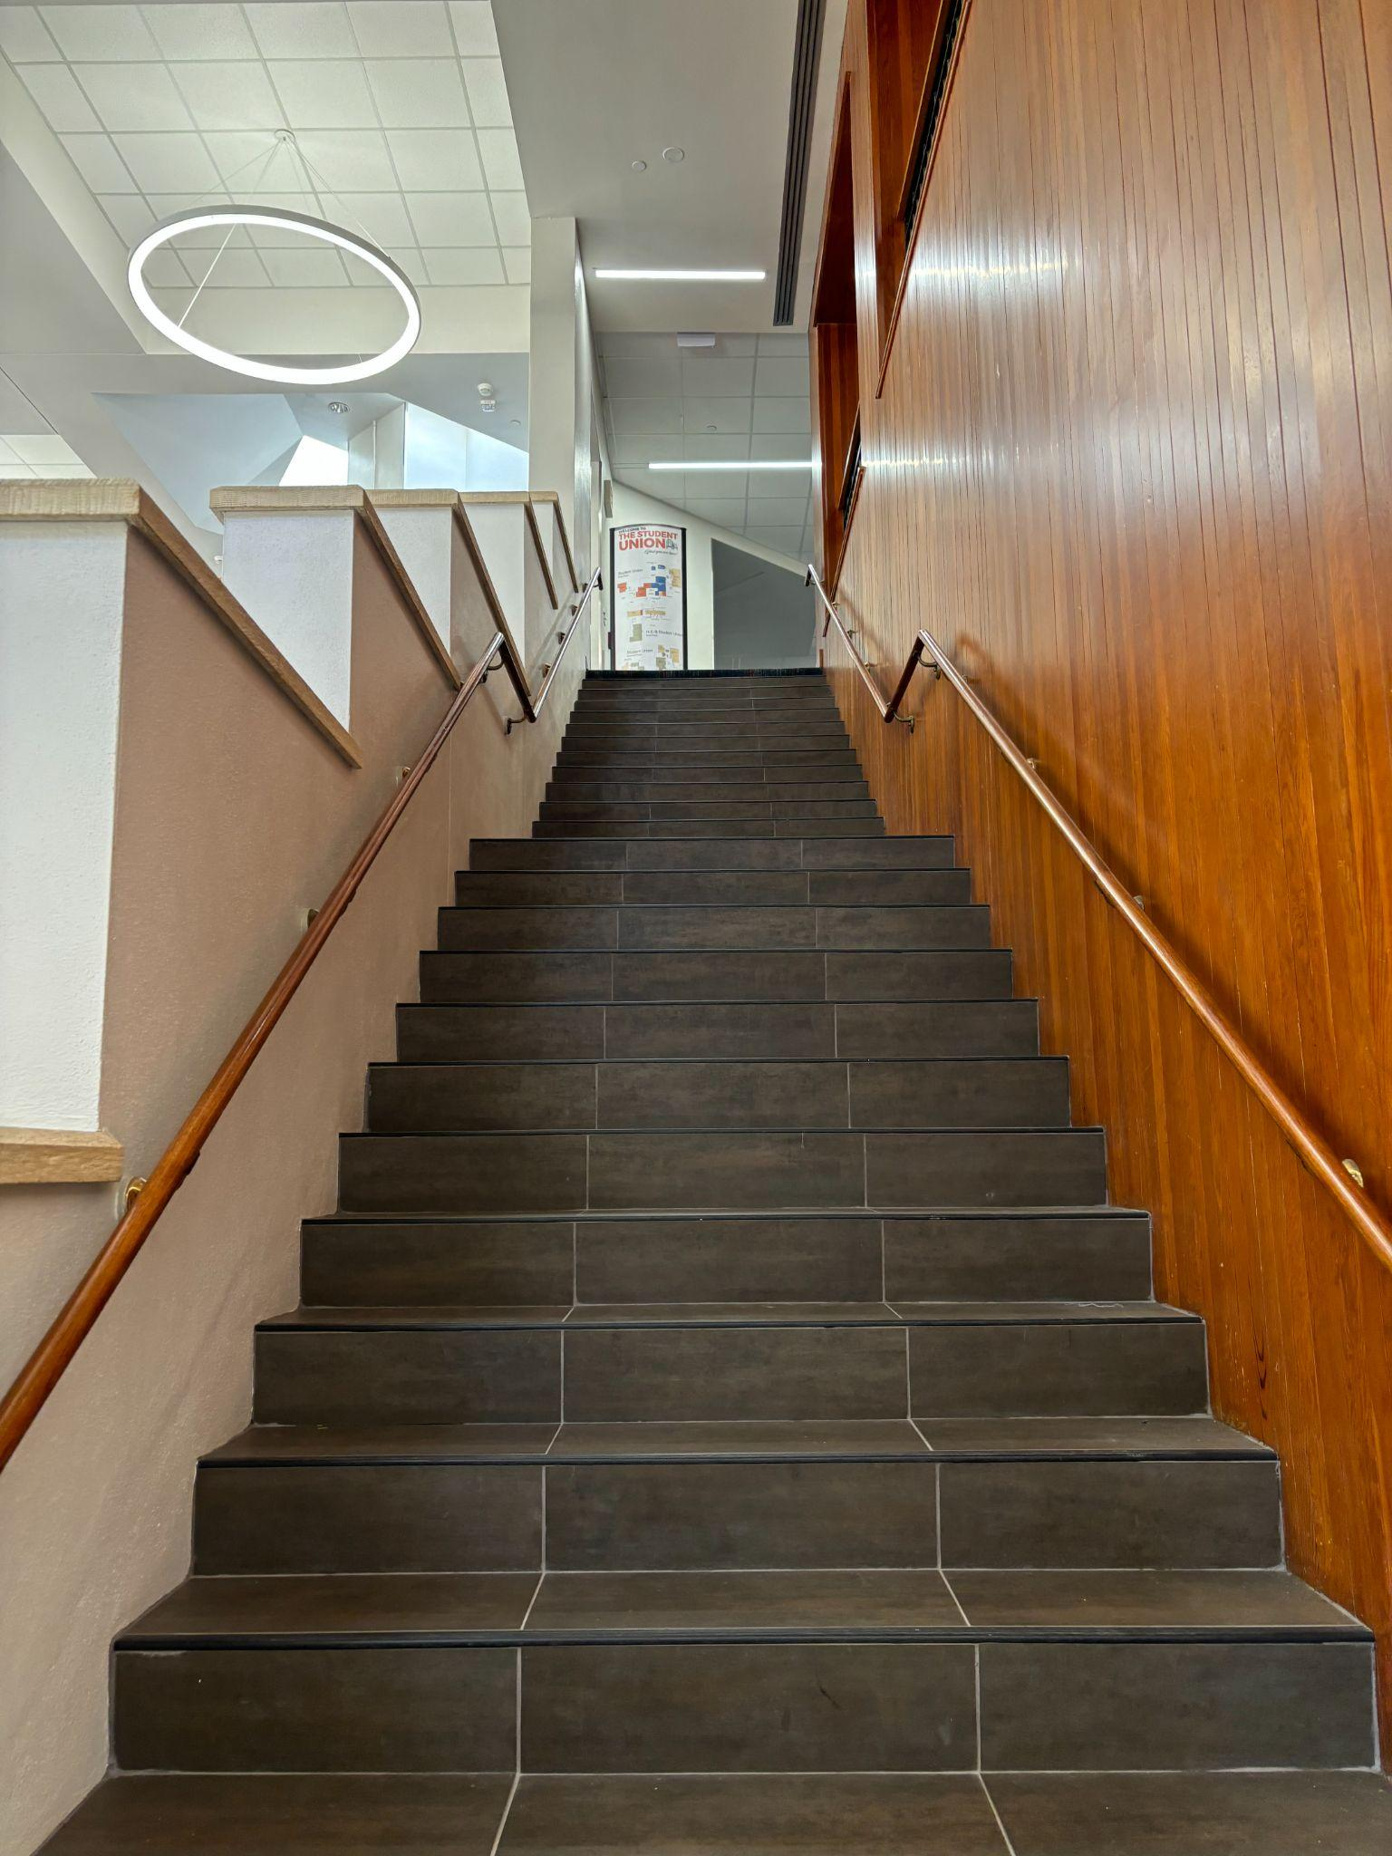
Interior Directions
Head up the stairs immediately inside the entrance of the building and turn right to reach the ballroom. There will be a table where you will sign in.
Air Force ROTC Detachment 842 • We Build Exceptional Officers • The University of Texas at San Antonio

Slide 8
Contact Info
Campus Police: 210-458-4242
C/Cavazos: 210-556-6991, Julia.Cavazos@my.utsa.edu
C/Campbell: 210-473-4701, shaydon.campbell@my.utsa.edu
Maj Cavazos: TinaRose.Cavazos@utsa.edu
Mr.Llano: Agustin.Llano@utsa.edu
Air Force ROTC Detachment 842 • We Build Exceptional Officers • The University of Texas at San Antonio

Slide 9
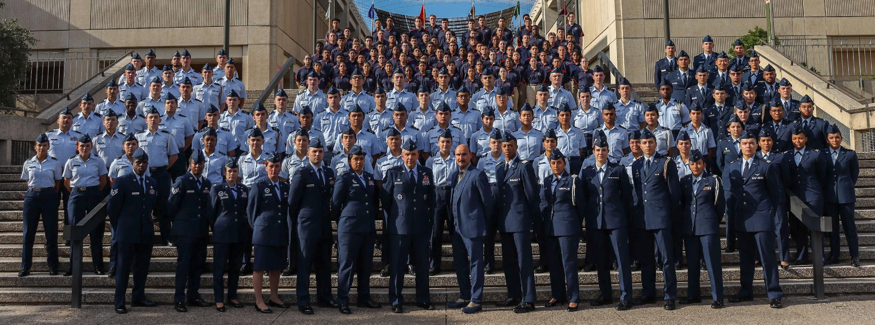
Air Force ROTC Detachment 842
The University of Texas at San Antonio
Det 842 – Best in Blue

